Slide 1
MACROeconomics
lecture 07: Inflation & unemployment
Dr. Hemantha Premarathne,
Department of Social Sciences,
KDU
B.A. Econ & Stat (Hons) Pera, M.A. & Ph.D. (Saga, Japan)

Slide 2
Content of the Lecture
  7.1 Introduction
  7.2 Methods of Measuring Inflation
  7.3 Types of Inflation
  7.4 Inflation, Deflation & Disinflation
  7.5 Unemployment

Slide 3
What is Inflation?
7.1 Introduction
Inflation is defined as the percentage increase in the average price level in a given period of time.
When we talk about inflation of a country, we
indicate the increase in the general price level,
not increase in the price of specific commodities.

Slide 4
7.2 Methods of Measuring Inflation
There are two common methods of measuring inflation:
i). Price change in Price Index Numbers (PIN)
ii). Change in GNP Deflator.
i). Measuring Inflation by PIN
PINt - PINt-1
Rate of Inflation =
×
100
PINt-1
PINt :
Price index no in the year selected for measuring inflation
PINt-1 :
Price index no in the previous year
The two widely used PINs are:
i. Wholesale Price Index (WPI) or Producer Price Index (PPI)
ii. Consumer Price Index (CPI)

Slide 5
Conti…
i). Measuring Inflation by PIN
Ex.. Assume that the WPI (2019- = 100) for all commodities increased from 134.6 in 2020 to 141.9 in 2021. The rate of inflation between 2020 and 2021 can be calculated as follows.
141.9 - 134.6
Rate of Inflation =
×
100
134.6
Rate of Inflation = 5.4 %

Slide 6
Conti…
ii). Measuring Inflation by GNP Deflator
Nominal GNP
GNP Deflator (%) =
×
100
Real GNP
Nominal GNP : GNP at current prices
Real GNP : GNP at constant prices
Rate of Inflation =
(GNP Deflator)t - (GNP Deflator)t-1
×
100
(GNP Deflator)t-1

Slide 7
7.3. Types of Inflation
Inflation is generally classified on the basis of its rate and causes. On the rate basis, inflation is classified as follows.
i). Moderate inflation
ii). Galloping inflation
iii). Hyper inflation

Slide 8
Conti…
i). Moderate Inflation
When the general level of price rises a moderate rate over a long period of time, it is called “moderate inflation or creeping inflation”.
Moderate rate of inflation may vary from country to country. However, ‘a single digit’ rate of annual inflation is called ‘moderate inflation’.
An important feature of moderate inflation is that it is ‘predictable’.
During the period of moderate inflation, people continue to have faith in the monetary system and confidence in ‘money as a store of value’. Money continues to work as a medium of exchange and people continue to hold money as asset.

Slide 9
Conti…
ii). Galloping Inflation
The economists have different views on galloping inflation.
“Galloping inflation refers to an inflation that proceeds at an exceptionally high rate’’ (Baumol & Blinder). They do not specify what rate of inflation is ‘exceptionally high’.
“ inflation in the double or triple-digit range of 20 or 100 percent a year is labeled galloping inflation’’ (Samuelson & Nordhaus). However, double and triple –digit inflation ranges between 10 and 99 percent and economic effects of inflation in this range will be immensely different.

Slide 10
Conti…
iii). Hyper Inflation
In general, a price rise at more than three-digit rate per annum is called ‘hyper inflation’ .
According to some economists, “hyperinflation is often as inflation that exceeds 50 precent per month….”
During the period of hyper inflation, paper currency becomes worthless and demand for money decreases dramatically.
Example… Germany in 1922 to 1923, Hungarian inflation in 1945-46.

Slide 11
7.4 Inflation, Disinflation and Deflation
Inflation refers to a persistent increase in the general price level
Deflation means fall in the general price level below the base-year level.
Disinflation means decline in the rate of inflation.
Example: if the general price level is 100 in year 1 and it is 90 in year 2 then we call it deflation.
Example: If the general price level is 100 at the end of year 1 and at the end of year 2 it is 110, then the rate of inflation in year 2 is 10%. In year 3 if the price level is 120 then the rate of inflation is 9.09%. In this case the inflation rate falls from year 2 to year 3 and will be called disinflation.

Slide 12
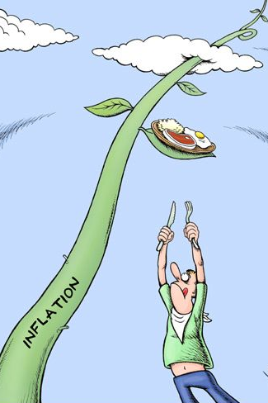
Ins and
Outs of
Inflation

Slide 13
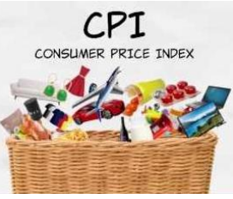
Consumer Price Index (CPI)
The Consumer Price Index (CPI) measures the monthly change in prices paid by the consumers.

Slide 14
Steps involved in the calculation of CPI
Deciding the numerical approach (Laspeyer’s, Paasche’s method)
Selecting abase year
Selecting a Sample and Observe Patterns of consumption
Selecting a representative basket of goods
Weighting (based on the importance of each goods)
Find the price
Compute the basket’s cost

Slide 15
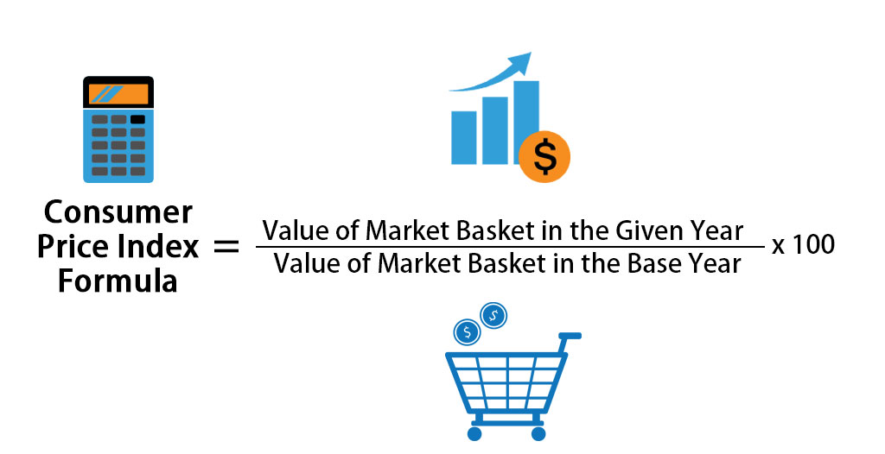

Slide 16
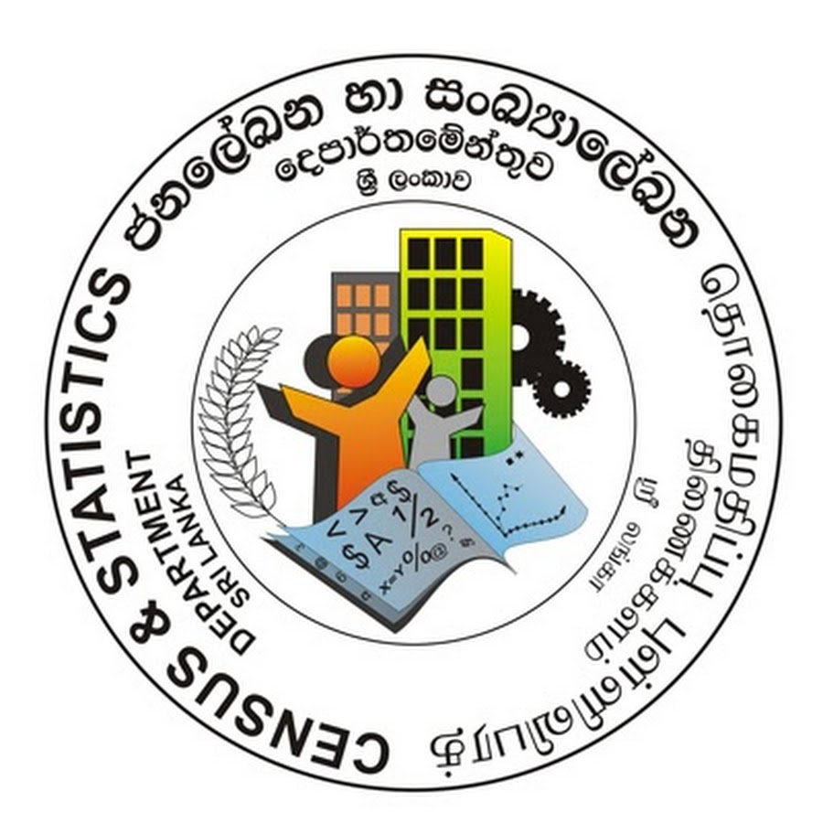
CCPI (Base 2021=100)
CCPI (Base 2013=100)
CCPI (Base 2006/2007=100)
CCPI (Base 2002=100)
CCPI (Base 1952=100)
NCPI (Base 2021=100)
NCPI (Base 2013=100)

Slide 17
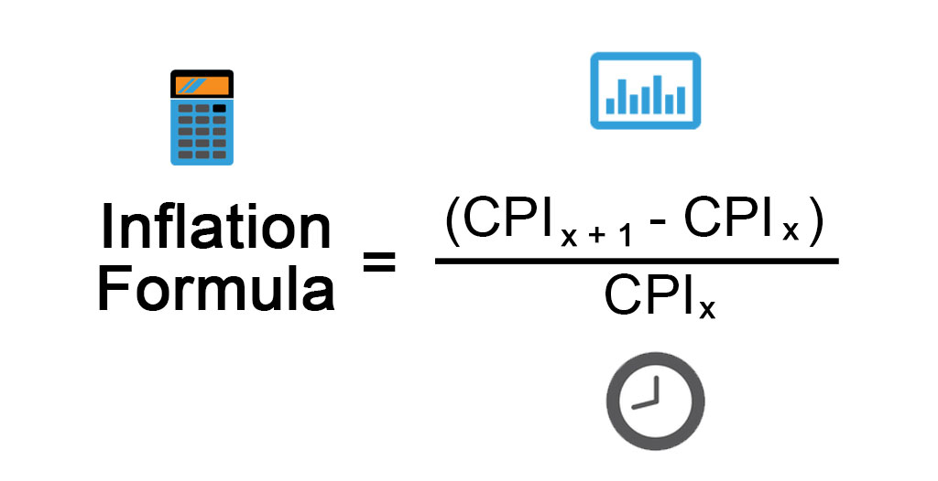

Slide 18
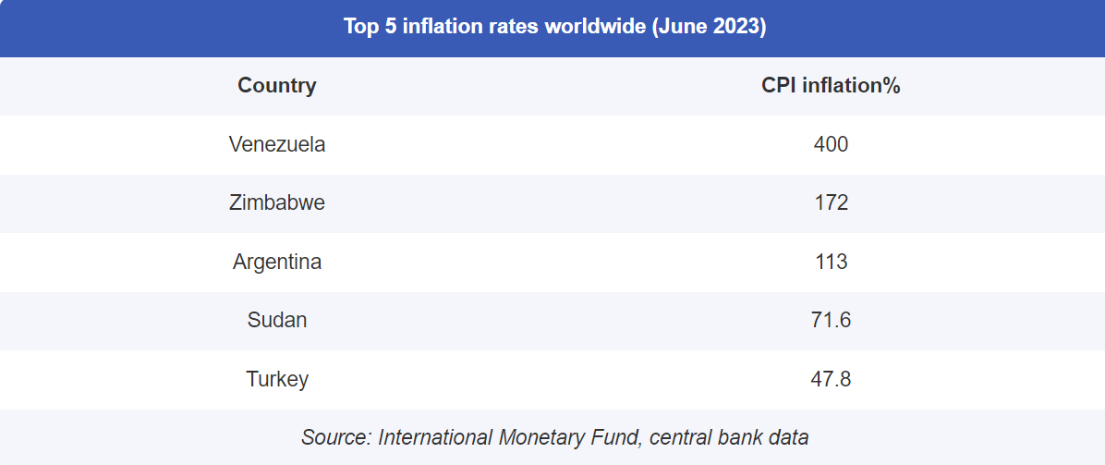

Slide 19
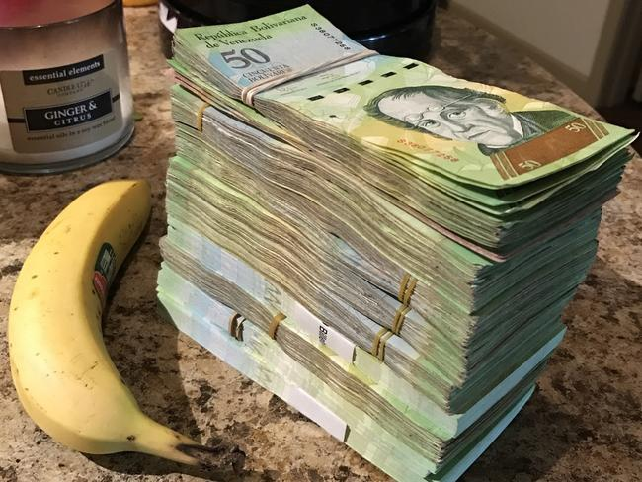
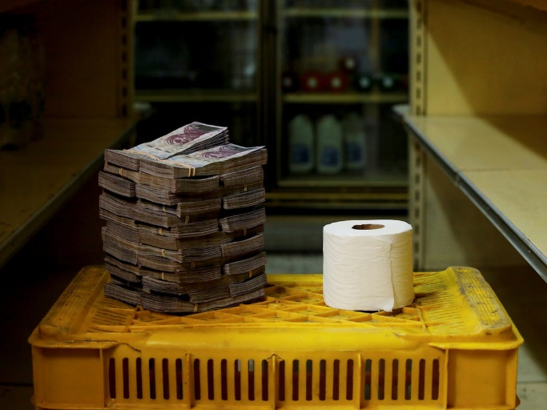
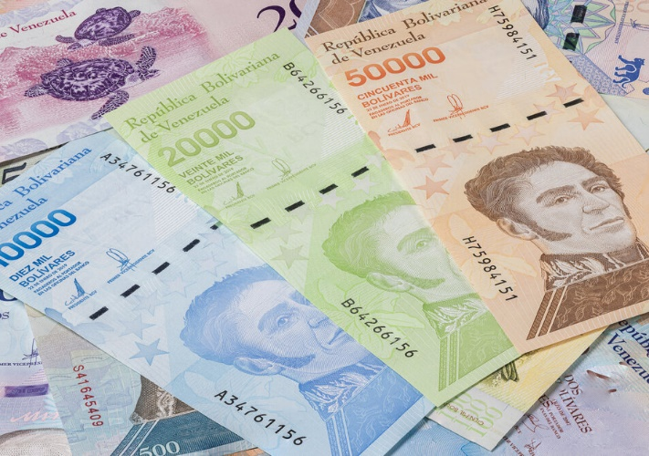
Inflation in Venezuela ( Currency - Bolivar)

Slide 20
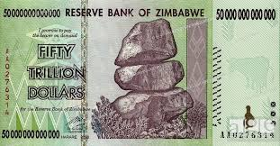
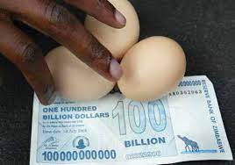
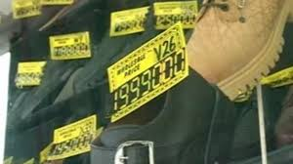
Inflation in Zimbabwe (100 trillion Zimbabwe-dollar banknote)

Slide 21
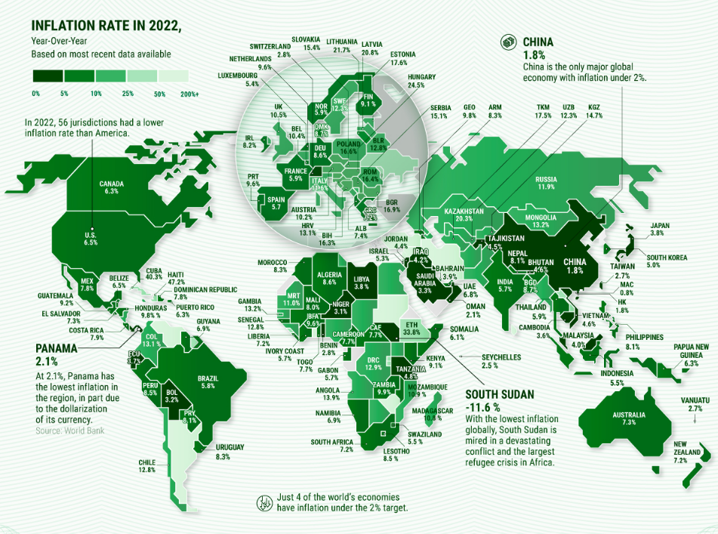

Slide 22
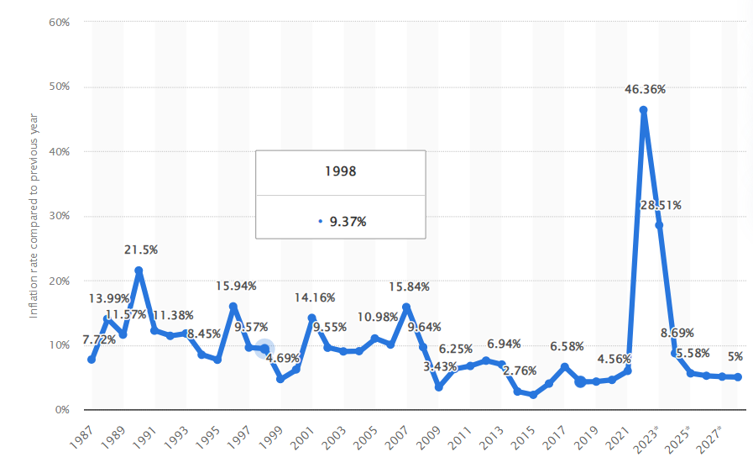

Slide 23
India inflation rate for 2022 was 6.70%, a 1.57% increase from 2021.
India inflation rate for 2021 was 5.13%, a 1.49% decline from 2020.
India inflation rate for 2020 was 6.62%, a 2.89% increase from 2019.
India inflation rate for 2019 was 3.73%, a 0.21% decline from 2018.

Slide 24
South Asia inflation rate for 2022 was 7.20%, a 1.65% increase from 2021.
South Asia inflation rate for 2021 was 5.55%, a 0.15% decline from 2020.
South Asia inflation rate for 2020 was 5.69%, a 2.06% increase from 2019.
South Asia inflation rate for 2019 was 3.63%, a 0.3% increase from 2018.

Slide 25
Inflation is the continuous increase of the general price level in the economy.
Decline in the rate of inflation is disinflation.
A continuous decline in the general price level is regarded as a deflation.

Slide 26
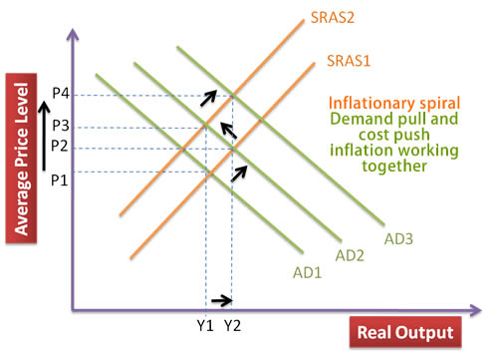
Causes of Inflation
Causes and Effects of Inflation
  Demand pull inflation
  Cost push inflation
  Structural Inflation (rigidity, limitations and inelasticities in the economic structure)

Slide 27
Importance of CPI
to calculate inflation rate
to adjust social security benefits
to measure international competitiveness
to forecast future average price levels and consumer expenditure
used as a deflator

Slide 28
Basic Components | CCPI |  | CCPI (N)
Base Period | Outdated | 1952 | More Recent | 2002
Reference Population | Limited | Working Class | Increased | All urban
Geographical Coverage | Narrow | Colombo City | Wider | Colombo District
Sample Size | Lower | 455 householders | Higher | 1300 Households
Price Collection Centers | Few | 07 | More | 12
No of Items | Low | 213 | High | 334
Total Basket Value | 202.24 |  | 17,996.38

Slide 29
According to the ILO recommendations, CPI should cover all types of consumer goods and services of significance to the reference population.
  Without any omission of goods that may not be legally available or may be considered socially undesirable
  Tobacco and alcohol beverages are excluded in the CCPI’s basket item – old index.

Slide 30
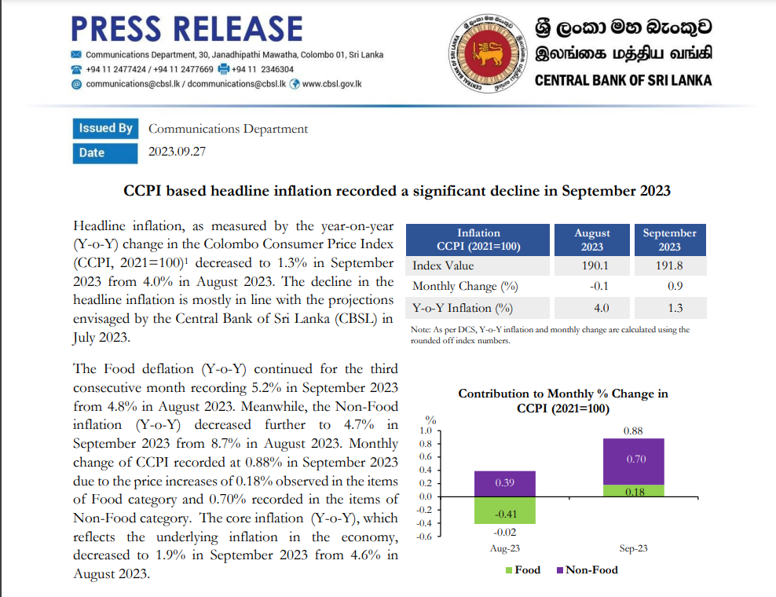

Slide 31
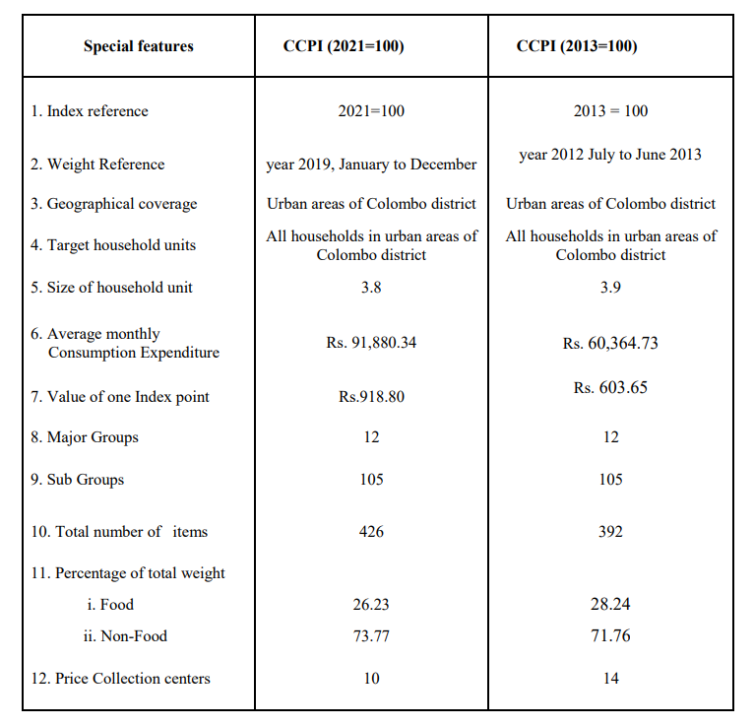

Slide 32
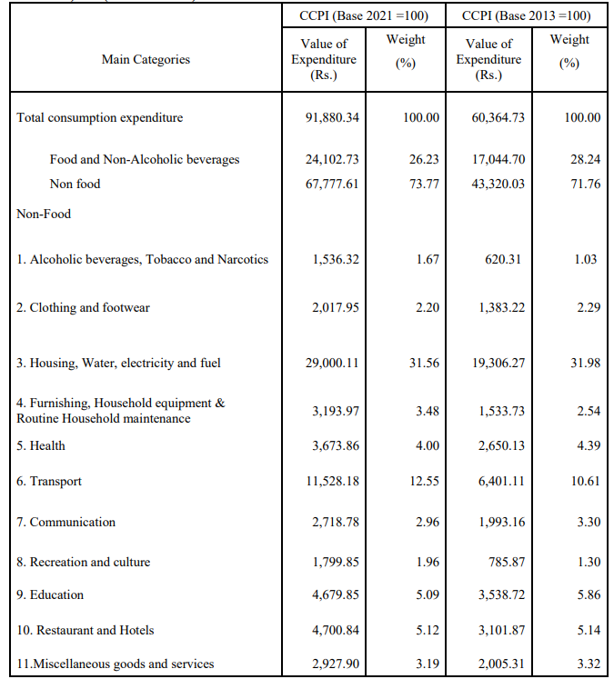

Slide 33
Problems involved in the construction of CPI
“Substitution Bias”
“Introduction of New Goods”
“Unmeasured Quality Change”
It is assumed that high and low income level families are spread equally in the area.
There should be a base year with minimum price fluctuations. It is very difficult to find a year with that requirement.
The consumption patters of households are changing continuously.

Slide 34
Therefore,
It’s likely that no one method of calculating the consumer price index would satisfy everyone.
it’s unrealistic to expect the majority of people to agree on a way to determine the CPI that eliminates all bias.

Slide 35
Effects of Inflation
Decline in the real value of money has adverse effects on fixed income earners, depositors and creditors.
Variable income earners and debtors are benefited by inflation.
Price increases→ purchasing power of money→ prefer to owning hard assets

Slide 36
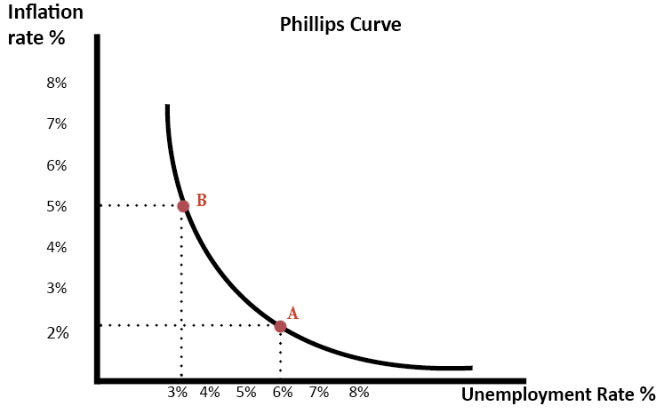
Inflation and Unemployment

Slide 37
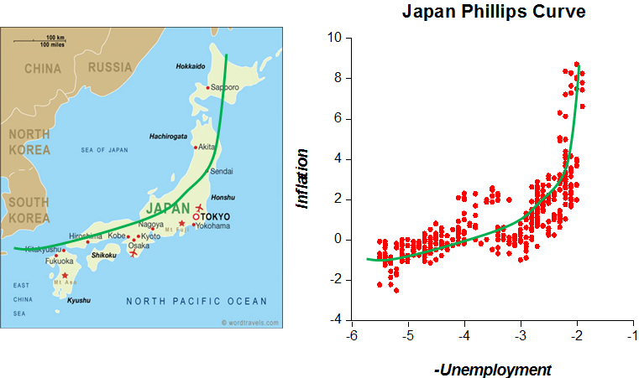

Slide 38
Control inflation
Monetary policies and monetary policy management can be used to control inflation

Slide 39
Thank you!

Slide 40
7.5 Unemployment
Unemployment is defined by the International Labor Organization (ILO) as “a situation in which people are without jobs and they have actively looked for a job for the past four weeks”.
According to this definition, people who do not look for a job will not be considered unemployed.

Slide 41
Cont…..
Productive population
In the labor force
Not in the labor force
Employed
Unemployed
Labor force: Labor force of a country consists of persons belonging to the age group of 15 to 65 years (or so) who are employed and those who are unemployed but are looking for a job. Labor force does not include full-time students, full-time house-wives and retired persons.

Slide 42
Cont….
Measuring Unemployment Rate
Labor force – Employed labor
×
Unemployment rate =
100
Labor force
or
Number of unemployed labor
×
Unemployment rate =
100
Labor force

Slide 43
Cont…
Kinds of Unemployment
The unemployment can be classified under four categories as follows
1. Frictional unemployment: caused by temporary job loss. For example: when workers switch jobs they might be unemployed for a short period as long as they find a suitable job.
2. Structural unemployment: caused by a permanent shift of events. For example: if a country shuts down its jute factories and starts readymade garments industries then workers of the jute industry may find it very difficult to find a job in the readymade garments industry as the skills set does not match.

Slide 44
Cont…
3. Natural rate of unemployment: it is the level of unemployment when the economy is at the full employment level. The natural rate of unemployment is a combination of both frictional and structural unemployment.
4. Cyclical unemployment: it is the deviation of natural rate of unemployment form the actual employment.

